Slide 1
Iterative Improvement II

Slide 2
Iterative Improvement
Used for optimization problems
Start with a feasible solution
Repeat until no improvement can be found:
Change the current feasible solution to a feasible solution with a better value of the objective function
Typically, change is “small” (local search)
Return the last feasible solution as optimal

Slide 3
Bipartite Graph Matching

Slide 4
Bipartite Graphs
Bipartite Graph: graph whose vertices partitioned into two disjoint sets V and U, not necessarily same size, so every edge connects a vertex in V to a vertex in U
V
1
2
3
4
5
U
6
7
8
9
10
Imagine adding a link between 1 & 4: no longer bipartite.
Notes:
Bipartite: 2-colorable. No cycles of odd length.

Slide 5
Bipartite Graphs
Affiliation Networks, e.g. players & teams
Task Assignment
Clustering, e.g. queries & ad clicks

Slide 6
Matching in a Graph
Matching: subset of edges in a graph such that no two edges share a vertex.
Maximum Matching: a matching with largest number of edges
Always exists, not always unique
V
1
2
3
4
5
M = {(4,8),(5,9)}
U
6
7
8
9
10
Notes:
Maximum Cardinality Matching

Slide 7
Iterative Improvement Maximum Matching
Given a matching, vertices are either matched or free. (Can start from {})
Matched: {4, 5, 8, 9} Free: {1, 2, 3, 6, 7, 10}
Free vertices = opportunity to increase matching.
If all of U or V is matched, no further increases.
V
1
2
3
4
5
M = {(4,8),(5,9)}
U
6
7
8
9
10

Slide 8
Iterative Improvement Maximum Matching
Given a matching, vertices are either matched or free.
Matched: {1, 4, 5, 6, 8, 9} Free: {2, 3, 7, 10}
Easy to add link between free vertices.
What happens when no edge available?
V
1
2
3
4
5
M = {(4,8),(5,9)} add (1,6)
U
6
7
8
9
10

Slide 9
Augmenting Path
Augmenting Path: path from vertex in V to vertex in U, where edges in path alternative between being in E-M and M.
Add edges not in M to M, remove edges already in M
Since odd # of edges (start and end not in M), will increase cardinality of matching M.
V
1
2
3
4
5
U
6
7
8
9
10
Notes:
One edge paths are a sub-case of augmenting paths.

Slide 10
Augmenting Path
Augmenting Path: path from vertex in V to vertex in U, where edges in path alternative between being in E-M and M.
Another augmenting path?
V
1
2
3
4
5
U
6
7
8
9
10

Slide 11
Perfect Matching
Matching M is maximal iff no augmenting paths exist with respect to M.
Matching M is perfect if it matches all vertices in graph.
V
1
2
3
4
5
U
6
7
8
9
10

Slide 12
BFS to Find Augmenting Paths
Initialize Q = all vertices from one set, e.g. V
While Q is not empty, dequeue vertex w from Q and label all adjacent vertices u:
Case 1: (w in V)
If u is free, it is end point of path, labeling stops – move backwards along labels to original free vertex, augmenting matching
If u is not free, label u with w and enqueue it as front of Q.
Case 2: (w not in V)
Label w with its mate in V.
When Q is empty, return current matching

Slide 13
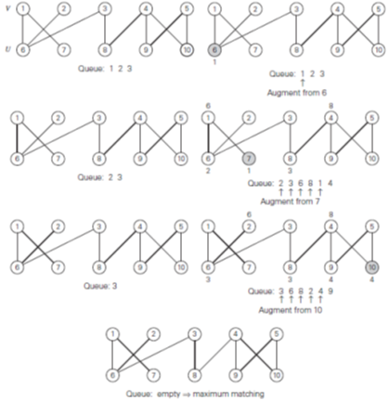
BFS
Notice final matching differs from earlier example, but is still maximal.

Slide 14
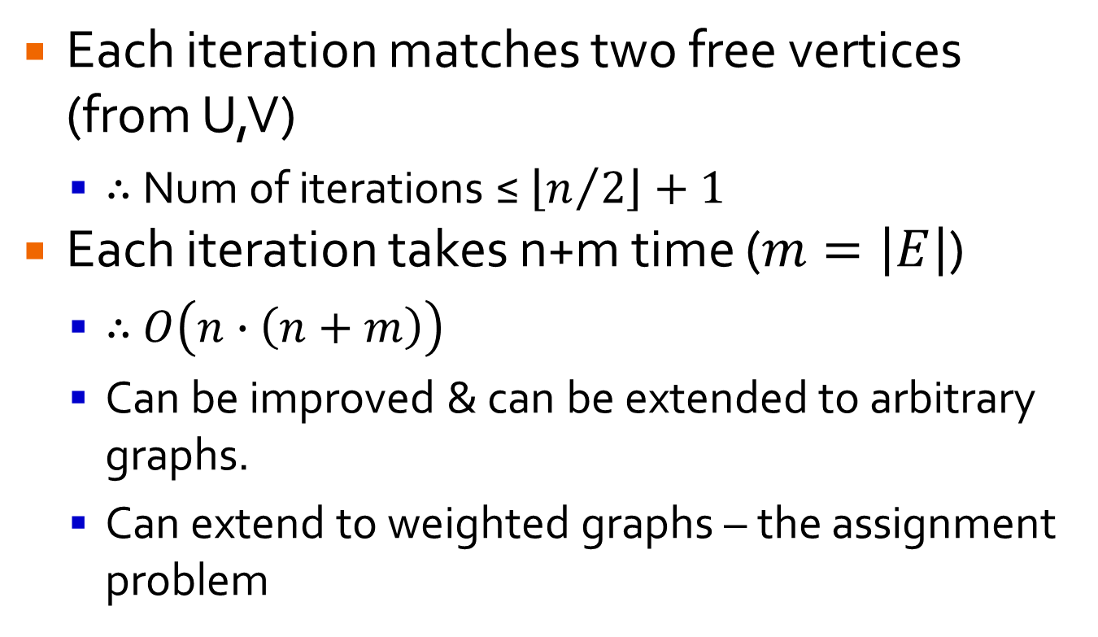
Efficiency
Each iteration matches two free vertices (from U,V)
∴ Num of iterations ≤ $\left\lfloor n/2\right\rfloor +1$
Each iteration takes n+m time ($m=\left|E\right|$)
∴ $O\left(n∙\left(n+m\right)\right)$
Can be improved & can be extended to arbitrary graphs.
Can extend to weighted graphs – the assignment problem

Slide 15
“Stable Marriage” Problem
Version of Bipartite Matching

Slide 16
Stable Marriage Problem
Sets Y = {m₁,…,m_{n}} of men, X = {w₁,…,w_{n}} of women
Each man m_{i} has a preference order of all women in X with no ties, and vice versa
Stored in ranking matrix
 | 1st | 2nd | 3rd
Bo | Kim | Aya | Nia
Jax | Kim | Nia | Aya
Tom | Nia | Kim | Aya
 | 1st | 2nd | 3rd
Aya | Jax | Tom | Bo
Kim | Tom | Bo | Jax
Nia | Jax | Tom | Bo
 | Aya | Kim | Nia
Bo | 2,3 | 1,2 | 3,3
Jax | 3,1 | 1,3 | 2,1
Tom | 3,2 | 2,1 | 1,2

Slide 17
Stable Marriage Problem
A marriage matching M is set of pairs (m_{i},w_{j})
The stable marriage problem is to find a marriage matching with no blocking pairs:
(m,w) is a blocking pair if m and w are not matched and both prefer each other to their match.
e.g. M={(Bo,Aya), (Jax, Kim), (Tom, Nia)}} Is there a blocking pair?
 | Aya | Kim | Nia
Bo | 2,3 | 1,2 | 3,3
Jax | 3,1 | 1,3 | 2,1
Tom | 3,2 | 2,1 | 1,2

Slide 18
Man-Optimal Alg (Gale-Shapley)
Start with all men & women free
While free men exist, randomly select one, m:
m proposes to highest-ranked w who has not rejected him before.
If w is free, she accepts the proposal. If w is not free but she prefers m to her current match, she accepts and her current mate becomes free. Otherwise she rejects leaving m free.
Return the set of n matched pairs.

Slide 19
Example
 | Aya | Kim | Nia
Bo | 2,3 | 1,2 | 3,3
Jax | 3,1 | 1,3 | 2,1
Tom | 3,2 | 2,1 | 1,2
Free Men: Bo, Jax, Tom
Bo proposes to Kim
Kim accepts
 | Aya | Kim | Nia
Bo | 2,3 | 1,2 | 3,3
Jax | 3,1 | 1,3 | 2,1
Tom | 3,2 | 2,1 | 1,2
Free Men: Jax, Tom
Jax proposes to Kim
Kim rejects

Slide 20
Example
 | Aya | Kim | Nia
Bo | 2,3 | 1,2 | 3,3
Jax | 3,1 | 1,3 | 2,1
Tom | 3,2 | 2,1 | 1,2
Free Men: Jax, Tom
Jax proposes to Nia
Nia accepts
 | Aya | Kim | Nia
Bo | 2,3 | 1,2 | 3,3
Jax | 3,1 | 1,3 | 2,1
Tom | 3,2 | 2,1 | 1,2
Free Men: Tom
You continue …

Slide 21
Gale-Shapley Features
Terminates in no more than n² iterations
Is (wo)man-optimal
(Wo)man-optimal matching is unique.
Used for medical student residency matching.

Slide 22
Complexity & Limitations of Algorithms

Slide 23
Algorithms
Very powerful, but …
Some problems cannot be solved by any algorithm.
Some problems cannot be solved in polynomial time.
Most problems have a lower bound on how quickly any algorithm could solve them.
Not always easy to establish that lower bound.

Slide 24
How Good Is An Algorithm?
Selection Sort: O(n²)
Decrease & Conquer Towers of Hanoi: O(2^{n})
O(n²) is generally a good efficiency class and O(2^{n}) is generally a bad one.
But … could either task be accomplished more efficiently?
Knowing bound tells us what kind of improvement to aim for: constant factor or efficiency class
Bound is tight if an algorithm already exists from that efficiency class.

Slide 25
Efficiency Classes
θ(g(n)) – tight bound
useful for both algorithms and problems
O(g(n)) - upper bound
useful for algorithms
limited value for problems
Ω(g(n)) - lower bound
limited value for algorithms
useful for problems
We’ve been discussing efficiency of algorithms, so we’ve focused on O(g(n)) and θ(g(n)) .

Slide 26
Establishing Lower Bounds

Slide 27
Trivial Lower Bounds
Count number of input items that must be processed / number of output items that must be produced.
e.g. algorithm for producing permutations of n Є Ω(n!) – output size.
Bound is tight – Decrease and Conquer algorithm (4.3)

Slide 28
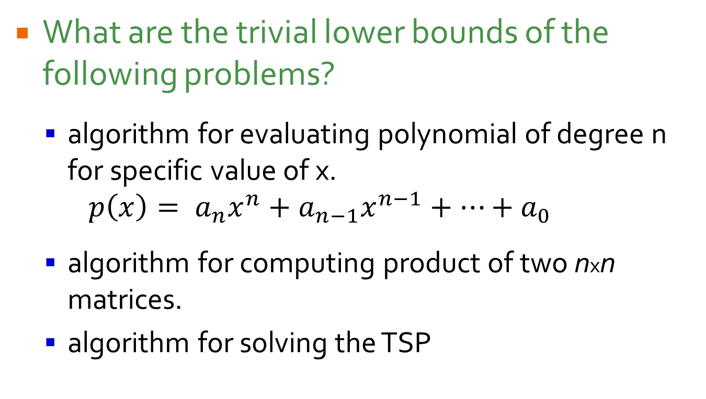
Trivial Lower Bounds
What are the trivial lower bounds of the following problems?
algorithm for evaluating polynomial of degree n for specific value of x. $p\left(x\right)= a_{n}x^{n}+a_{n−1}x^{n−1}+…+a_{0}$
algorithm for computing product of two nxn matrices.
algorithm for solving the TSP

Slide 29
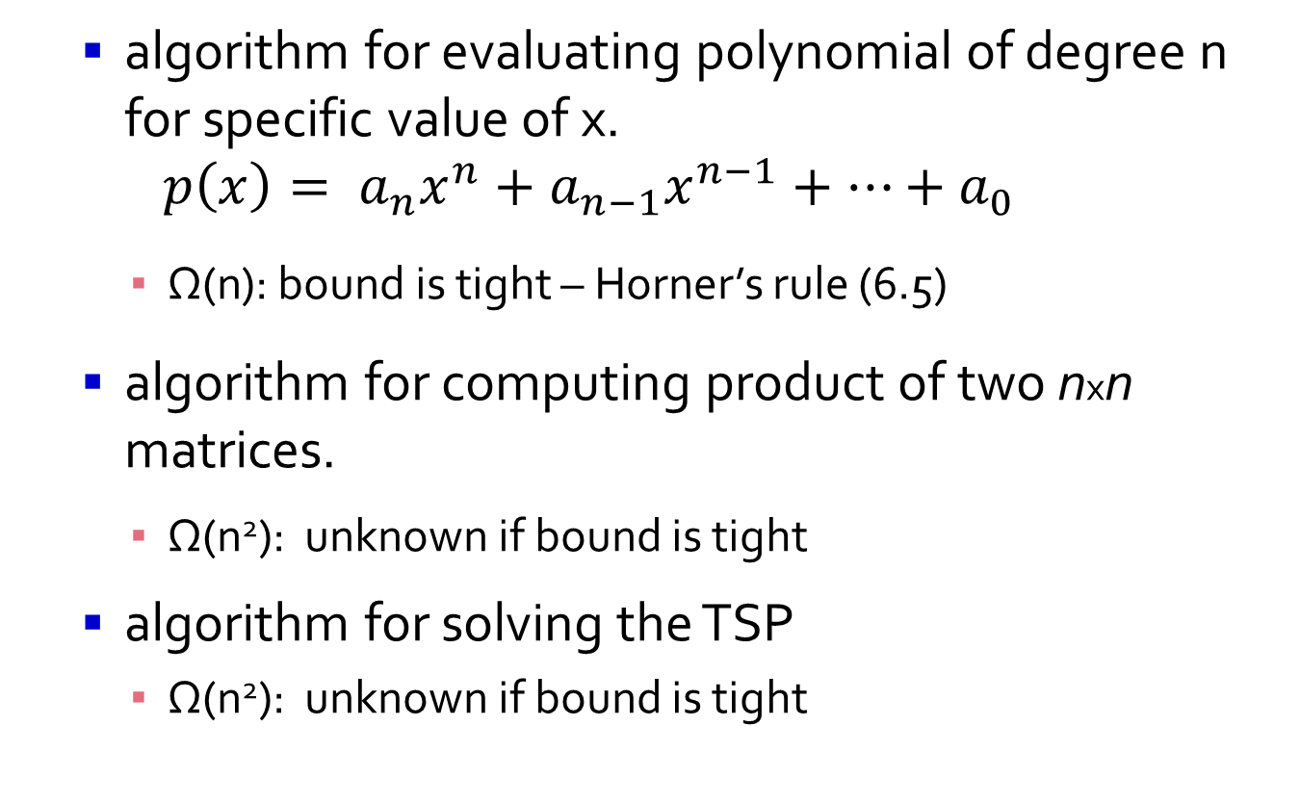
Trivial Lower Bounds
algorithm for evaluating polynomial of degree n for specific value of x. $p\left(x\right)= a_{n}x^{n}+a_{n−1}x^{n−1}+…+a_{0}$
Ω(n): bound is tight – Horner’s rule (6.5)
algorithm for computing product of two nxn matrices.
Ω(n²): unknown if bound is tight
algorithm for solving the TSP
Ω(n²): unknown if bound is tight

Slide 30
Trivial Lower Bounds
May be too low to be meaningful
e.g. TSP, no known polynomial algorithm of any degree, let alone n².
Not always clear how much of input needs to be processed
e.g. searching a sorted array or determining connectivity of undirected graph.

